Slide 1

Multi-screen Apps
CIS 399

Slide 2
Course Overview
Wk | Topic
1 | Intro, single-screen apps
1 | Activity Lifecycle, saving activity state
2 | Layouts + widgets, Event Handlers
2 | Themes + styles, Menu + settings
2 | Multi-screen apps
Wk | Topic
3 | Fragments
3 | Reading XML files, Asynch Tasks
3 | List Views
3 | SQLite Database
4 | Consuming a web service
4 | Geolocation

Slide 3
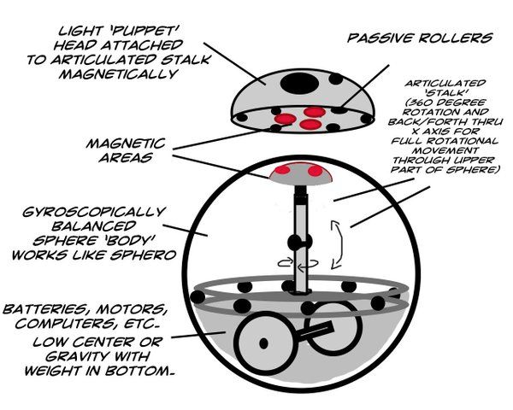
Android Application Architecture
Notes:
BD-8 Architecture

Slide 4
Android App Architecture
Apps are made up of components. There are four kinds of components:
Activity
Each screen is managed by it’s own activity
A multi-screen app will have multiple activities
An app must have at least one activity

Slide 5
App Architecture (continued)
Services: long-running background operations
Content providers: manage shared data
Broadcast receivers: respond to system-wide broadcast announcements
Intent objects are used to activate activities, services, and broadcast receivers
Every app must have a manifest file

Slide 6
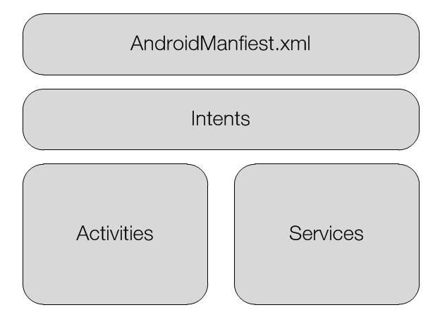
Components of an App
and Broadcast receivers, and Content providers

Slide 7
Activity class
Provides a user interface (UI)
Contains a window in which to add UI elements
Inherits from the abstract Context class
Each activity in a app is independent of the others
Can be activated from within it’s own app or by another app

Slide 8
Loosely Coupled Activities
Typical desktop apps have a single entry point. In an Android app, any activity (screen) can be an entry point.
Similar to web applications. You can typically directly open any web page in a site.

Slide 9
Context class
Provides a reference to the current application
Provides a means to access the Android operating system
Used for:
Accessing Android services
Accessing preferences (settings) and permissions
Creating new views (widgets, aka controls)
Accessing device resources

Slide 10
Intent class
A class that contains a message
It specifies an action for the OS or an activity to perform
Most often used to start activities
Can also start services or deliver broadcasts
It can carry data
Notes:
https://developer.android.com/guide/components/intents-filters.html

Slide 11
AndroidManifest.xml
Required for every application
Registers information about the app:
Components that make up the application (including activities, services, broadcast receivers, and content providers)
Required permissions
Minimum OS version supported
Notes:
https://developer.android.com/guide/topics/manifest/manifest-intro.html

Slide 12
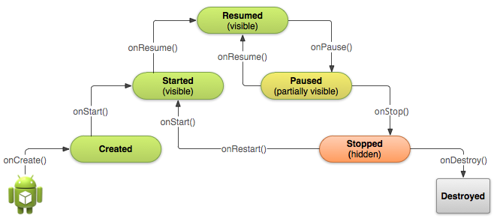
Activity Lifecycle
From http://developer.android.com/training/basics/activity-lifecycle/

Slide 13

Starting an
Activity

Slide 14
Activity Launched by the App
Each app must have an activity that is started when the app is launched.
This activity is specified in the manifest:
<activity android:name=".MainActivity" android:label="@string/app_name" > <intent-filter> <action android:name= "android.intent.action.MAIN" /> <category android:name= "android.intent.category.LAUNCHER" /> </intent-filter> </activity>
Notes:
<intent-filter> specifies the type of intent that an activity can respond to
android.intent.action.MAIN means that this activity is the entry point of the application
android.intent.category.LAUNCHER means that this activity should be displayed in the top-level launcher

Slide 15
Adding Additional Activities
For each activity in your app you need to:
Write a class that is derived from Activity or AppCompatActivity
Declared in the same way as the main activity
Write an XML layout for the activity’s UI
Defined in the same way as the main layout
Add an <activity> element to the manifest for this activity
Add code to an existing activity that will start the new activity
Add a navigation feature so you can return to a pervious activity

Slide 16
startActivity method
A method of the Context class (base class for the Activity class)
Requires an Intent object
Specifies the activity to be started
Carries data to the activity (optional)
Example: Intent intent = new Intent(this, SecondActivity.class); intent.putExtra("humanHand", humanHand); startActivity(intent);

Slide 17

The up Button
Navigates up to the parent activity
To add an up button to the app bar:
First ensure your activity has an app bar by:
Using a theme that includes an ActionBar or AppBar, like android:Theme.Holo.Light.DarkActionBar
Or, adding a Toolbar to the activity (see the following slides)
In the manifest, add an attribute for the activity’s parent: android:parentActivityName=".MainActivity"
Notes:
https://developer.android.com/design/patterns/navigation.html

Slide 18
Aside: ActionBar vs. Toolbar
A “side-bar” about the two types of app bar
The ActionBar was introduced with Android 3.0 (API level 11), all activities that use the default theme have an ActionBar.
However, the native ActionBar behaves differently depending on the API level. Not all features are available for older APIs.
For example: the native action bar doesn't support material design unless the device is running Android 5.0 (API level 21) or later.
By contrast, all features are available on the support library's version of Toolbar.
For example, the Toolbar widget provides a material design experience on devices running Android 2.1 (API level 7) or later.
For this reason, you should use the support library's Toolbar class to implement your activities' app bars.
Notes:
https://developer.android.com/reference/android/widget/Toolbar.html
https://developer.android.com/design/patterns/actionbar.html

Slide 19
Aside: Adding a Toolbar to an Activity
Add the v7 appcompat support library to your project, see: https://developer.android.com/topic/libraries/support-library/setup.html
Make sure the activity extends the AppCompatActivity class: public class SecondActivity extends AppCompatActivity
In the manifest, set a NoActionBar theme: android:theme="@style/Theme.AppCompat.Light.NoActionBar"
Add a Toolbar to the top of the activity's layout: <android.support.v7.widget.Toolbar android:id="@+id/toolbar" android:layout_width="match_parent" android:layout_height="?attr/actionBarSize" android:background="?attr/colorPrimary" android:elevation="4dp" android:theme="@style/ThemeOverlay.AppCompat.ActionBar" app:popupTheme="@style/ThemeOverlay.AppCompat.Light" android:layout_alignParentTop="true" android:layout_alignParentRight="true" android:layout_alignParentEnd="true" />
In onCreate(), call the activity's setSupportActionBar() method: Toolbar toolbar = (Toolbar) findViewById(R.id.toolbar); setSupportActionBar(toolbar);
Notes:
Support Library Setup: https://developer.android.com/topic/libraries/support-library/setup.html
Modify build.gradle to use your support library: https://developer.android.com/topic/libraries/support-library/setup.html#libs-with-res
Toolbar tutorial: http://www.vogella.com/tutorials/AndroidActionBar/article.html#using-the-toolbar

Slide 20
Exercise
Modify the Tip Calculator to put an “up” button on the settings activity by adding an entry for the parent in it’s section of the the manifest.

